Slide 1
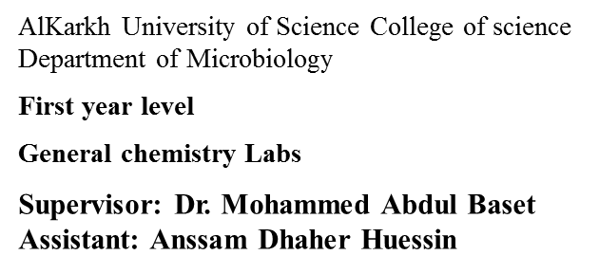
Lab -6-
TITRATING SODIUM CARBONATE WITH HYDROCHLORIC ACID
1. Introduction:
Laboratory grade hydrochloric acid is not sufficiently pure to use as a primary standard. In this experiment, a standard solution of sodium carbonate use to determine the exact concentration of a hydrochloric acid solution.
Sodium carbonate reacts with dilute hydrochloric acid in two stages.
The end points for the two stages can be found using suitable indicators. The reaction can also be followed using a pH meter.
Two indicators are needed to cover both stages:
• in stage 1, phenolphthalein (pH= 8-10) is most suitable, and will respond to the pH change
associated with the formation of sodium hydrogen carbonate, NaHCO3.
• in stage 2, methyl orange (pH= 3.1-4) is most suitable, and will respond to the pH change
associated with the final formation of sodium chloride, NaCl.
2. Objective: To determine the molarity of an unknown concentration of hydrochloric acid in two steps.
3. Materials and apparatus:
Ring stand, 1 Erlenmeyer flask, Phenolphthalein indicator, methyl orange indicatori, buret, DI water, unknown HCl, double bure, clamp, 0.1 M Na2CO3(aq), 2 beakers, funnel
4. Procedure (method):
1) Use a pipette and safety filler to put 10.0 ml of approximately 0.1 mol.dm⁻³ (M) sodium carbonate solution into a small conical flask.
2) Add 2-3 drops of phenolphthalein indicator. The solution should be red-pink.
3) Titrate with HCl from a burette until the last traces of pale pink colour have disappeared. Note down the burette readings in the table below.
4) Add 3-4 drops of methyl orange. The solution should now be a yellow colour.
19

Slide 2
5) Continue to add acid from the burette until the solution just turns orange-red. Note down the final burette reading.
6) Repeat steps from 1 to 5 to get concordant titres for the two end points.
5. Calculation:
A - with using phenolphthalein
VI (HCl) = 1/2 Na2CO3 2V = all Na2CO3
(M.V)ac₁d=(M'.V')base n n
(M.V)acid= (M'.V')base M = (M'.V')base / 2 V
Na2CO3+2HCl ^ 2NaCl+CO2 + H2O
B - with using methyl orange
(M.V)acid = (M'.V')base n n
(M.V)acid=(M'.V')base M = (M'.V')base / V
Na2CO3+HCl ^ NaCl + NaHCO3
6. Conclusions:
The molarity of the given for sodium carbonate was_M.
7. Questions:
1. In using a burette, why is it important?
(a) to rinse it with a little of the solution it is going to contain,
(b) to clamp it vertically,
(c) to have the part below the tap full?
2. Explain why hydrochloric acid is not used as a primary stand
20

